Slide 1
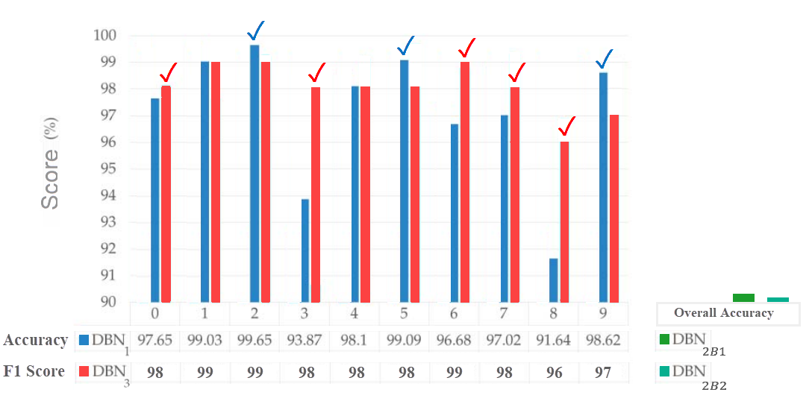












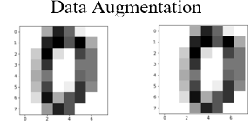
Name: Ashraf Haress
Findings from DBN Comparative Analysis
ID: 196280

